Slide 1
Programming Language II CSE-215
Prof. Dr. Mohammad Abu Yousuf
yousuf@juniv.edu

Slide 2
Multithreaded Programming-1

Slide 3
Introduction
Java provides built-in support for multithreaded programming.
A multithreaded program contains two or more parts that can run concurrently. Each part of such a program is called a thread, and each thread defines a separate path of execution.
Thus, multithreading is a specialized form of multitasking.

Slide 4
Introduction
Two distinct types of multitasking:
process-based Multitasking(Multiprocessing)
thread-based Multitasking(Multithreading)

Slide 5
Introduction
Process-based Multitasking(Multiprocessing) :
A process is, in essence, a program that is executing.
Each process have its own address in memory i.e. each process allocates separate memory area.
Thus, process-based multitasking is the feature that allows your computer to run two or more programs concurrently.
For example, process-based multitasking enables you to run the Java compiler at the same time that you are using a text editor or visiting a web site.
Cost of communication between the process is high.
Switching from one process to another require some time for saving and loading registers, memory maps, updating lists etc.

Slide 6
Introduction
Thread-based Multitasking (Multithreading):
Threads share the same address space.
In a thread-based multitasking environment, the thread is the smallest unit of dispatchable code. This means that a single program can perform two or more tasks simultaneously.
For instance, a text editor can format text at the same time that it is printing, as long as these two actions are being performed by two separate threads.
Cost of communication between the thread is low.

Slide 7
Introduction
Multiprocessing and multithreading, both are used to achieve multitasking. But we use multithreading than multiprocessing because threads share a common memory area. They don't allocate separate memory area so saves memory, and context-switching between the threads takes less time than process.
Note: At least one process is required for each thread.

Slide 8
Introduction
Advantages of Java Multithreading:
1) It doesn't block the user because threads are independent and you can perform multiple operations at same time.
2) You can perform many operations together so it saves time.
3) Threads are independent so it doesn't affect other threads if exception occur in a single thread.

Slide 9
Introduction
What is Thread in java:
A thread is a lightweight sub process, a smallest unit of processing. It is a separate path of execution.
Threads are independent, if there occurs exception in one thread, it doesn't affect other threads. It shares a common memory area.
Note: At a time one thread is executed only.

Slide 10
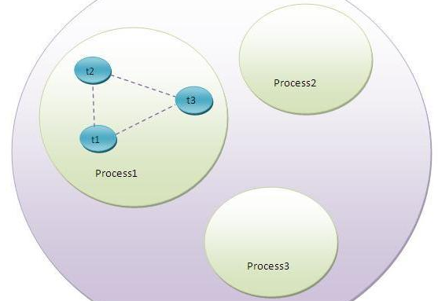
Introduction
OS
As shown in the above figure, thread is executed inside the process. There is context-switching between the threads. There can be multiple processes inside the OS and one process can have multiple threads.

Slide 11
States of a thread
Threads exist in several states.
A thread can be running.
It can be ready to run as soon as it gets CPU time.
A running thread can be suspended, which temporarily halts its activity.
A suspended thread can then be resumed, allowing it to up where it left off.
A thread can be blocked when waiting for a resource.
At any time, a thread can be terminated, which halts its execution immediately. Once terminated, a thread cannot be resumed.

Slide 12
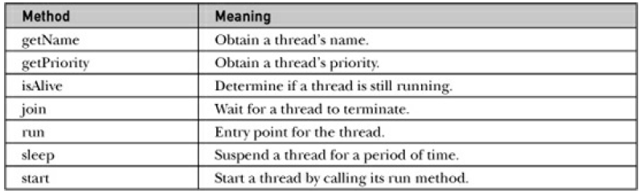
States of a thread
The Java Thread class defines several methods that help manage threads. Several of those used are shown here:

Slide 13
The Main Thread
When a Java program starts up, one thread begins running immediately.
This is usually called the main thread of your program, because it is the one that is executed when your program begins.
The main thread is important for two reasons:
1) It is the thread from which other “child” threads will be spawned.
2) Often, it must be the last thread to finish execution because it performs various shut down actions.

Slide 14
The Main Thread
Although the main thread is created automatically when your program is started, it can be controlled through a Thread object.
To do so, you must obtain a reference to it by calling the method currentThread(), which is a public static member of Thread.
This method returns a reference to the thread in which it is called. Once you have a reference to the main thread, you can control it just like any other thread.

Slide 15
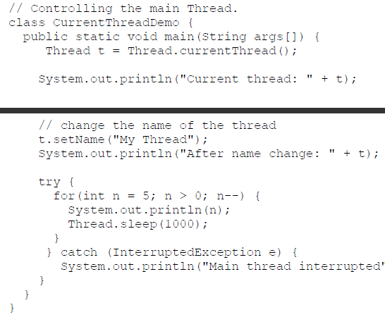
Example 1

Slide 16
Explanation of previous program
In this program, a reference to the current thread (the main thread, in this case) is obtained by calling currentThread(), and this reference is stored in the local variable t.
Next, the program displays information about the thread.
The program then calls setName() to change the internal name of the thread. Information about the thread is then redisplayed.
Next, a loop counts down from five, pausing one second between each line. The pause is accomplished by the sleep() method.

Slide 17
Explanation of previous program
Here is the output generated by this program:
Current thread: Thread[main,5,main]
After name change: Thread[My Thread,5,main]
5
4
3
2
1

Slide 18
Explanation of previous program
This displays, in order: the name of the thread, its priority, and the name of its group.
By default, the name of the main thread is main. Its priority is 5, which is the default value, and main is also the name of the group of threads to which this thread belongs.
A thread group is a data structure that controls the state of a collection of threads as a whole.
After the name of the thread is changed, t is again output. This time, the new name of the thread is displayed.

Slide 19
Explanation of previous program
The sleep( ) method causes the thread from which it is called to suspend execution for the specified period of milliseconds.
you can set the name of a thread by using setName().

Slide 20
Creating a Thread
In the most general sense, you create a thread by instantiating an object of type Thread.
Java defines two ways to create thread:
• By extending Thread class.
• By implementing Runnable interface.

Slide 21
Creating a Thread
Thread class:
Thread class provide constructors and methods to create and perform operations on a thread. Thread class extends Object class and implements Runnable interface.
Commonly used Constructors of Thread class:
Thread()
Thread(String name)
Thread(Runnable r)
Thread(Runnable r, String name)

Slide 22
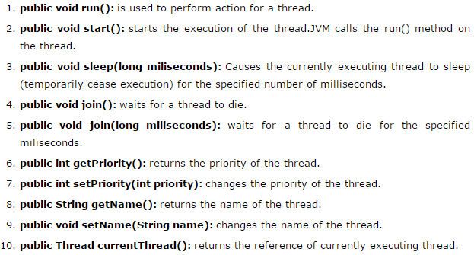
Creating a Thread
Commonly used methods of Thread class:

Slide 23
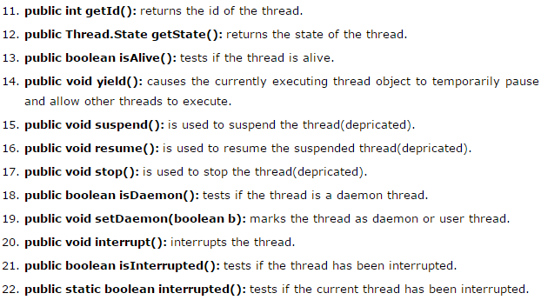
Creating a Thread
Commonly used methods of Thread class:

Slide 24
Creating a Thread
Java Thread Example by extending Thread class
class Multi extends Thread{
public void run(){
System.out.println("thread is running...");
}
public static void main(String args[]){
Multi t1=new Multi();
t1.start();
}
}
Output: thread is running...

Slide 25
Creating a Thread
Java Thread Example by implementing Runnable interface:
class Multi3 implements Runnable{
public void run(){
System.out.println("thread is running...");
}
public static void main(String args[]){
Multi3 m1=new Multi3();
Thread t1 =new Thread(m1);
t1.start();
}
}
If you are not extending the Thread class, your class object would not be treated as a thread object. So you need to explicitely create Thread class object. We are passing the object of your class that implements Runnable so that your class run() method may execute.
Output: thread is running...

Slide 26
Thank you

